Slide 1
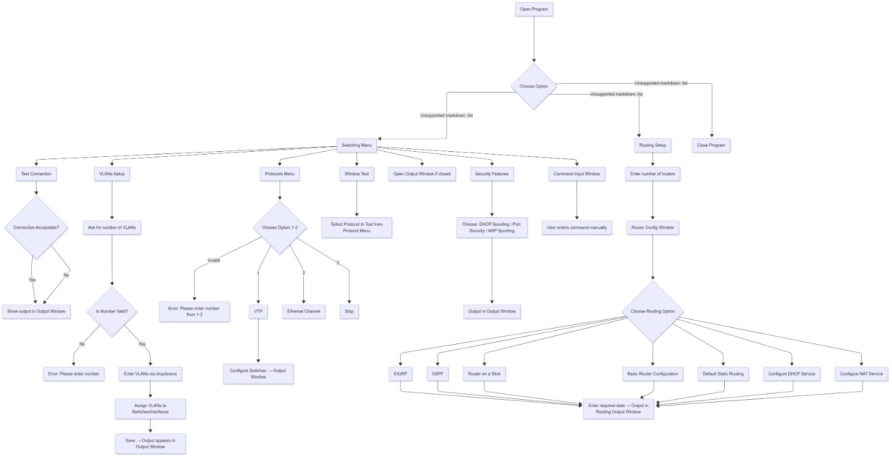
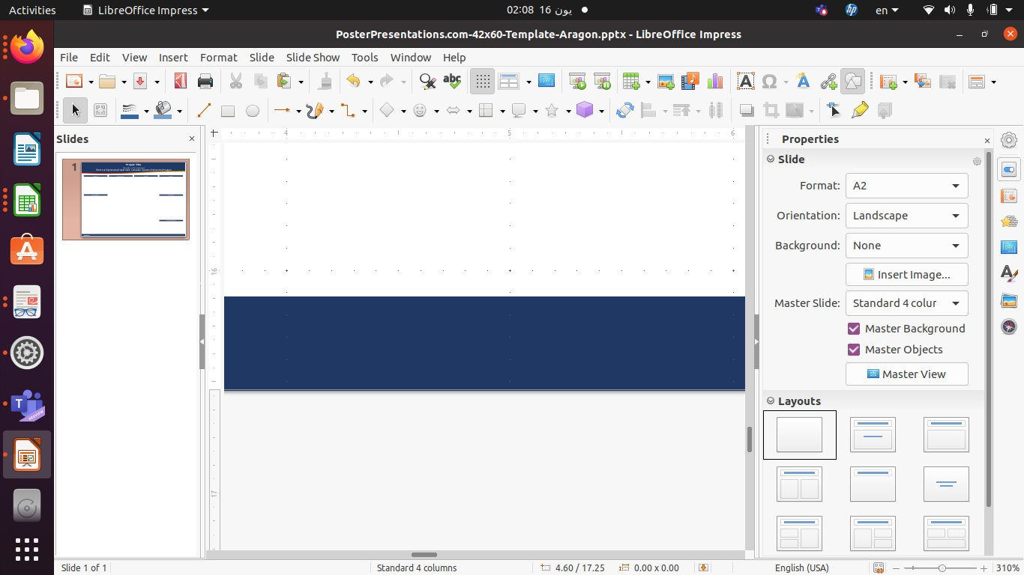
Netmiko ConfigPro: Automated Network Configuration and SecurityTool
Electrical Engineering Department, Communication and Electronics Engineering Program
Abstract
Methodology
“Netmiko ConfigPro" is a Python-based tool designed to automate the configuration and management of Cisco network devices, including routers and switches, using the Net- miko library. It provides a user-friendly GUI built with customtkinter, enabling network engineers to configure VLANs, routing protocols (EIGRP, OSPF, DSR), DHCP, NAT, and security features such as ARP protection, port security, and DHCP snooping. The tool supports multiple devices, allowing simultaneous configuration and monitoring, and includes features for testing connectivity and verifying configurations. By reducing man- ual configuration errors and enhancing security, this project aims to streamline network
management for both educational and enterprise environments. Additionally, the tool integrates a Security Information and Event Management (SIEM) solution to provide real_x0002_time monitoring, threat detection, and incident response, enhancing the overall security posture of the network.
Introduction
In modern network management, manually configuring devices like routers and switches is time-consuming and error-prone, particularly in large-scale environments. "Netmiko ConfigPro" addresses this challenge by providing an automated tool that simplifies the configuration process for Cisco devices. Built with Python, the Netmiko library, and a
customtkinter GUI, it offers an intuitive interface for managing VLANs, routing protocols, and security settings efficiently. The project integrates advanced security features like ARP protection and DHCP snooping, making it valuable for educational institutions and small to medium enterprises seeking to optimize network operations with minimal expertise.The project also incorporates a Security Information and Event Management (SIEM) solution, ensuring proactive threat detection and response, which is crucial for maintaining network security in dynamic environments.
Analysis
Conclusion
The tools performance was evaluated:
• Efficiency: Reduced configuration time by 70% compared to manual CLI methods.
• Accuracy: Eliminated human errors (e.g., syntax issues) via input validation.
• Security: Mitigated attacks (e.g., ARP flooding detected in 30 seconds).
• Scalability: Modular design supported adding features like NAT without disrup_x0002_tion.
• Limitations: Supports only Cisco IOS devices and requires stable SSH; latency
caused occasional failures, logged for debugging.
Netmiko ConfigPro" delivered an automated solution for network configuration and
security, meeting its goals of simplifying setup and enhancing security. Its intuitive GUI , reliable Netmiko integration,and SIEM-based monitoring enabled efficient VLAN
management, routing configuration, and attack mitigation. Future enhancements could include support for additional device types (e.g., Juniper), integration with more monitoring tools, and better error handling for unstable
connections, showcasing automations potential in network management.
Results
“Netmiko ConfigPro" successfully automated Cisco device configuration, achieving: • User Interface: Provided seamless interaction via GUI buttons ("Router Config- urator," "Switch Configurator," "Security") and real-time feedback. • Connectivity Testing: Achieved 100% ping success rate for reachable devices in the test topology. • Configuration Verification: Confirmed settings with commands like show vlan and show ip route. • VLAN Configuration: Created and assigned VLANs to switch ports, with options to add, remove, and verify. • Routing Protocols: Configured EIGRP, OSPF, and Default Static Routing on routers, with logs confirming successful route propagation. 2 • Security Implementation: Enabled DHCP snooping, port security, and ARP protection, successfully mitigating simulated attacks (e.g., ARP flooding). SIEM Monitoring: Successfully detected and mitigated simulated security threats, such as ARP looding and unauthorized DHCP server attempts, with real-time alerts and automated responses.
Supervisor and Team Members
Acknowledgment
1- Mohy Eldin Ehab Ibrahem
2- Mohamed Ahmed Ibrahem
3- Mohamed Saad Abdelnaem
4- Mohamed Yasser Abdelazez
5- Haidy Walid Mohamed Said
supervisor / Dr Mahaba Saad
We thank our supervisor, Dr/Mahaba , for her guidance, and the Electrical Engineering Department and Communication & Electronics Engineering Program for their resources.
We also acknowledge the open-source community for tools like Netmiko and customtkinter.

